Slide 1
KEYLOGGER
By : Mohammad Arze Hayat

Slide 2
Introduction
A keylogger can be special hardware or software that can record keystrokes as you type on a keyboard. You will be able to see passwords and usernames to various accounts (i.e bank accounts, email, etc), google earches, conversations that can be used to extort money or more information from a target, etc. Cybercriminals create fake websites or send an email embedding the keylogger in a malicious link or in a downloadable attachment known as a phishing attack.

Slide 3
Problem Statement
Cybersecurity Threat
Increasing Threat of Keyloggers:
Keyloggers are becoming more sophisticated and harder to detect.
Frequently used by cybercriminals to gather sensitive information.
Impact on Users
Consequences of Keylogger Attacks:
Data Breaches: Capture login credentials, leading to unauthorized access.
Financial Loss: Stolen financial information can result in monetary loss.
Identity Theft: Personal information used for identity theft, causing long-term damage.

Slide 4
Project Overview
First we install the python ide and then we install the two packages.
First one is pip pynput install.
Next one is johns library.
Then these two are used for controlling mouse and keyboard.
So we can use for keylogger security.
Above like that you can install it in command prompt.
By these two libraries we cannot get error in python code.

Slide 5
WHO ARE THE END USERS?
Cybersecurity Professionals
Purpose: To develop and implement countermeasures against keyloggers.
Ethical Hackers
Purpose: To conduct penetration testing and improve overall security posture.
Educators and Students
Purpose: To serve as a teaching tool illustrating the importance of cybersecurity measures.

Slide 6
Solution & Value Proposition
Keyloggers are surveillance technology that can record a device's activity and send it to a controlling entity. They can be hardware devices or software, and can be installed on a computer or smartphone. Keyloggers can be difficult to detect because they are designed to be silent and invisible. Here are some ways to protect against keyloggers:
Use security software
Install reputable antivirus and anti-malware software that can help detect and prevent keyloggers. Keep the software up to date to patch vulnerabilities that attackers might exploit.
Use virtual keyboards
For security-sensitive activities like entering passwords, you can use a virtual keyboard to thwart keyloggers that capture physical keystrokes.
Update your system
Regularly update your operating system, applications, and web browsers to patch vulnerabilities.
Use a firewall
A firewall can help monitor network traffic for suspicious activity. It can also provide strong authentication controls and help protect your data with encryption and access permissions.
To protect yourself from keyloggers:
Use Security Software:
Install reputable antivirus and anti-malware software that can help detect and prevent keyloggers. ...

Slide 7
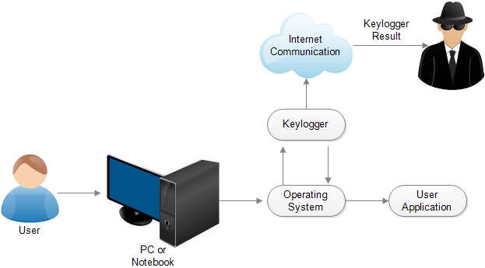
Technical Implementation

Slide 8
Result
Keyloggers are a potent threat to both individuals and enterprises, with the potential to cause significant harm if left undetected. Understanding the nature of keyloggers, their methods of infiltration, and the dangers they pose is crucial for maintaining a secure digital environment.

Slide 9
Github Link
arzehayat/APSSDC-CS-INTERNSHIP (github.com)

Slide 10
Thank You
By: Mohammad Arze Hayat

